Slide 1
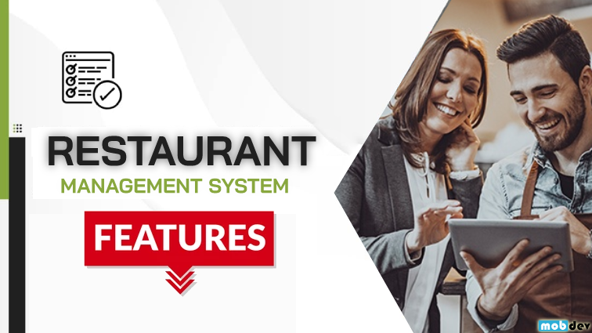
Restaurant Management System
Streamlined operations and enhanced customer experiences with our comprehensive restaurant management platform.

Slide 2
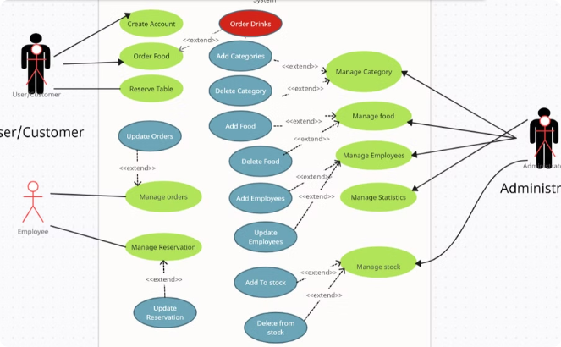
Use Case :
Gain a comprehensive understanding of the key features and data model that power our Restaurant Management System.
Use Case Overview
Explore the core functionalities that enable efficient restaurant operations and enhanced customer experiences.
From order management to employee scheduling, our system has you covered.

Slide 3
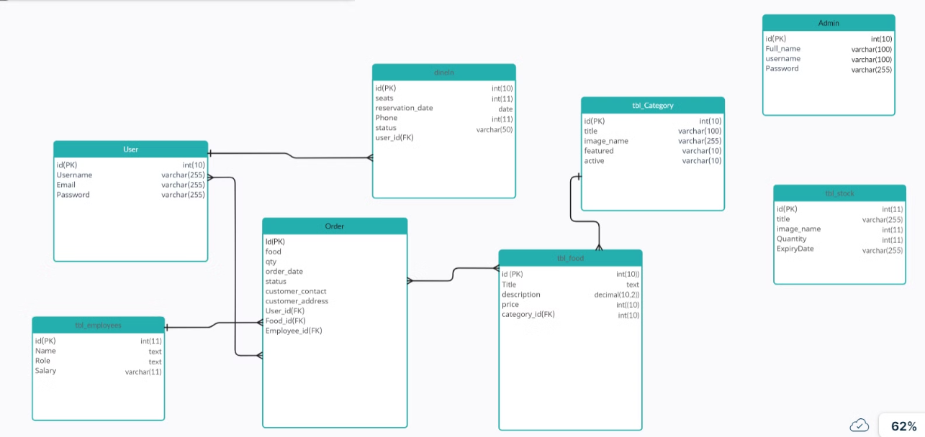
Er Diagram :
Explore Our Database Design which ensures a well functioning system.

Slide 4
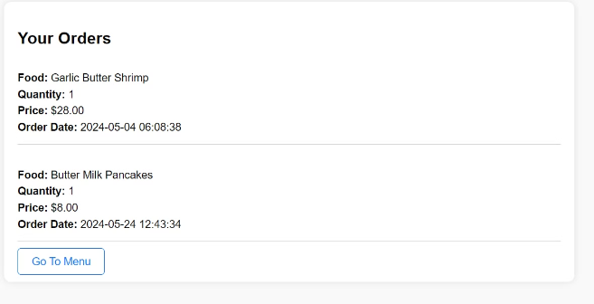
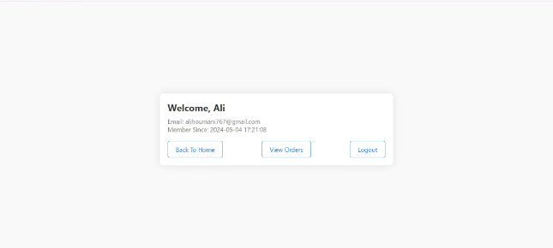
Customer Account
This is our user account which allows the customer to view their past orders and order history.

Slide 5
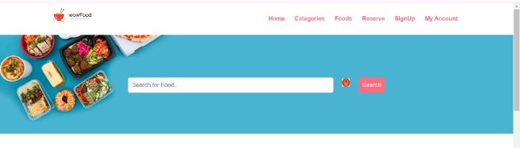
Customer Searching
Customers can easily search for their desired dishes or restaurant by entering keywords or by using their own voice . The search functionality provides accurate results, allowing customers to quickly find and select their preferred menu items.

Slide 6


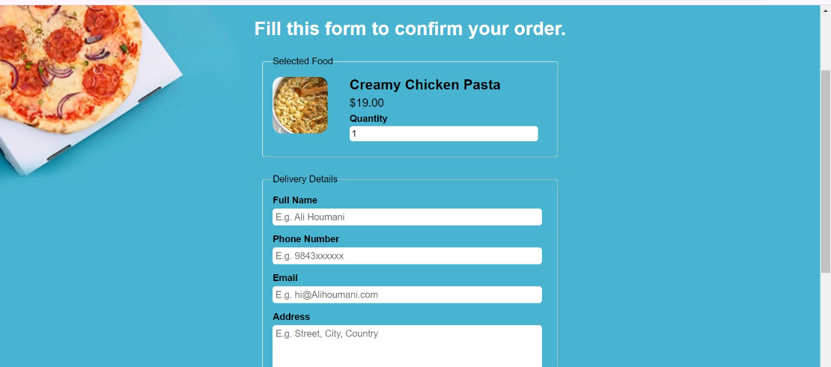
Ordering System
Browse Menu
Guiding interface
Customers can easily browse the restaurant's menu, view dish descriptions and prices, and select the items they want to order.
Customers can easily order through our ordering form

Slide 7

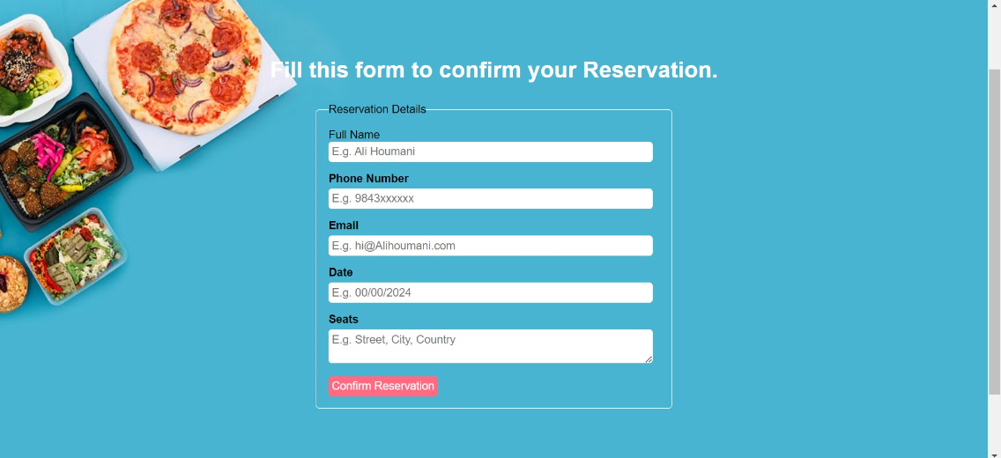
Reservation System
Make Reservation
1
Select date, time, and party size
Our reservation system makes it easy for customers to find available seating times that fit their schedule and group size. Guests can quickly book a table and receive a confirmation email with all the important details. The interface guides customers through the process step-by-step, ensuring a seamless experience.

Slide 8
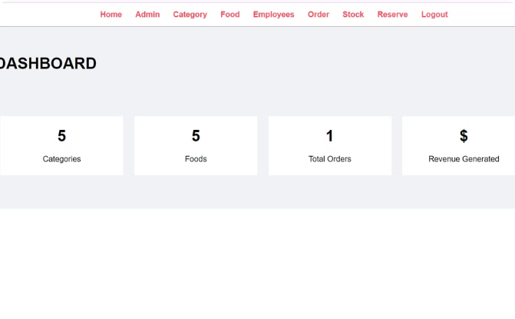
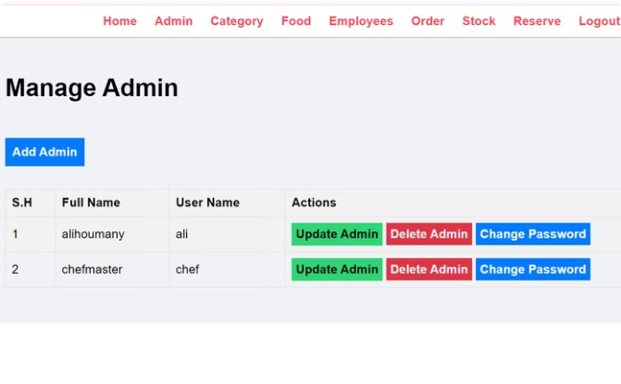
Admin Dashboard and Admin Manager
Comprehensive Control
Admin Managing
The admin dashboard provides a centralized hub for managing all aspects of the restaurant.
The admin manager allows the admin to take control over admins that controls the system

Slide 9
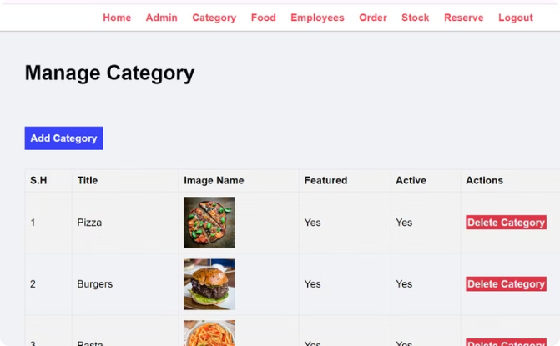
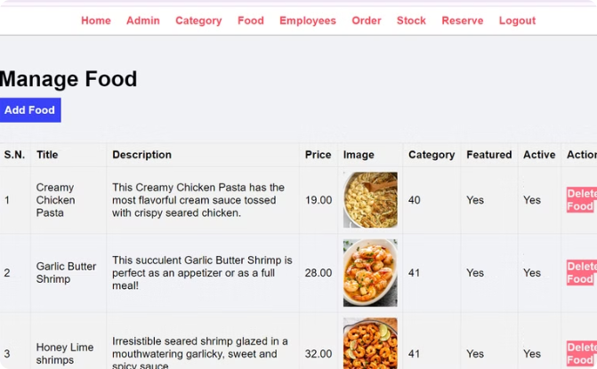
Categories and Food Managing
Category Manager
Food Manager
The Category Manager which allows the admin to display available categories for the user interface
The Food manager which allows the admin to add foods available into its related category

Slide 10
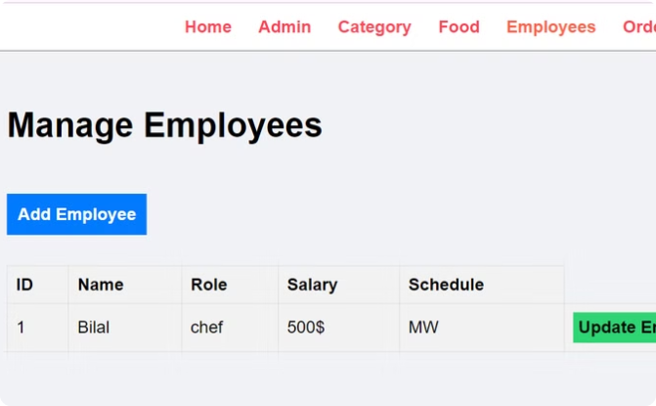
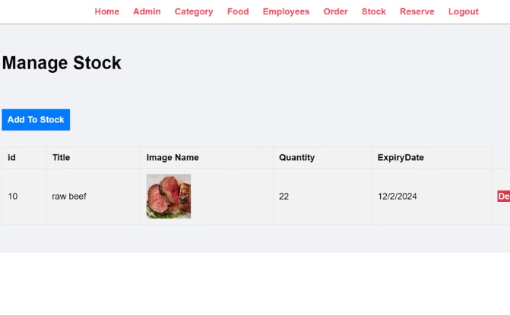
Stock and Employees Manager
Employees Manager
Stock Manager
The Employees Manager allows admin to Manage all details related to his staff
The Stock manager allows admin to keep track of available products in stock

